Slide 1
TIMBER : as a building material
Notes:
Timber
Advantages of using Timber
Classification of timber / Structure of wood / Seasoning
Strength properties of timber
Defects in timber
Preservatives
Treatments
Structural repairs and strengthening

Slide 2
What is difference between Wood and Timber..???

Slide 3
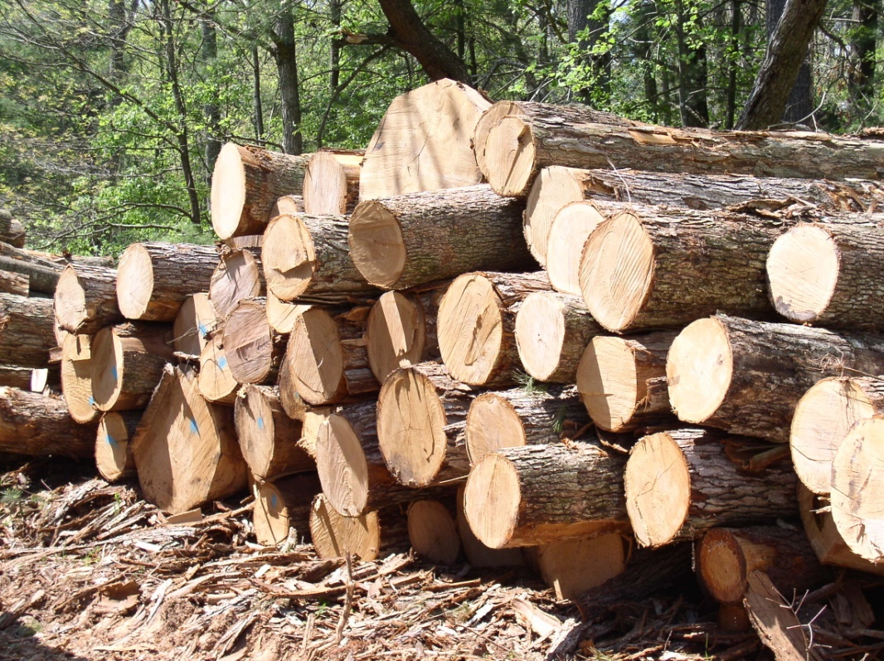
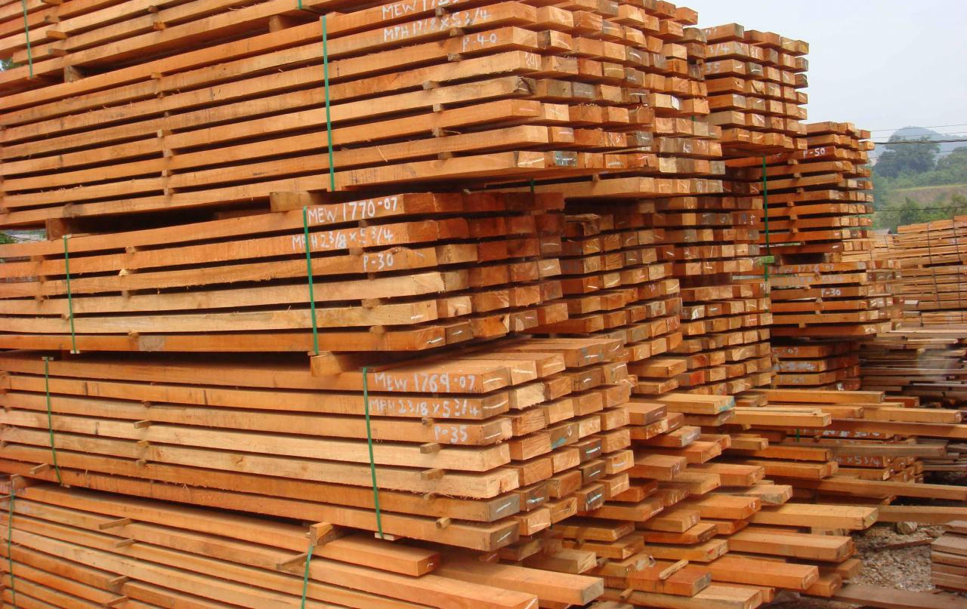
Wood can be defined as the material that forms the trunks and the branches of the trees.
Timber is wood cut from the trunk which can be used for constructing houses, boats, furniture and so on.

Slide 4
Timber is not only one of the oldest building materials, along with stone, and earth material, but has remained until today the most versatile and, in terms of indoor comfort and health aspects, most acceptable material.
However, timber is an extremely complex material, available in a great variety of species and forms, suitable for all kinds of applications.
Although only a small proportion of the timber harvested is used for building.
Since timber cannot be completely replaced by other materials, it shall long remain one of the most important building materials.
Notes:
3. the universal concern about the rapid depletion of forests, especially the excessive felling of large old trees (which take hundreds of years to replace) and the great environmental, climatic and economic disasters that follow deforestation, has led to a great deal of research into alternative materials and rationalized utilization

Slide 5
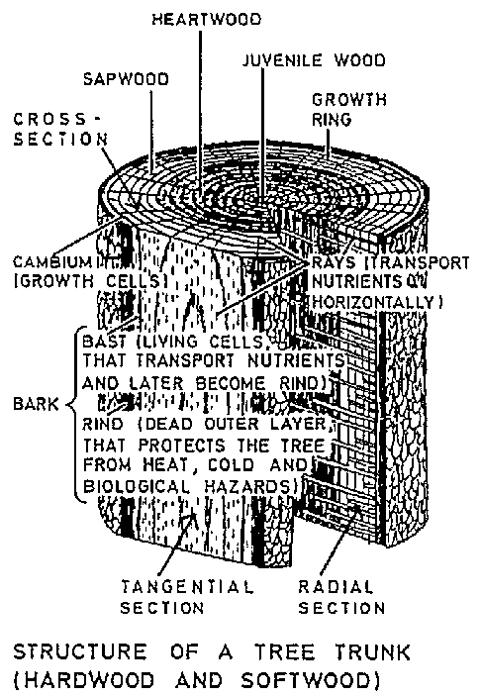
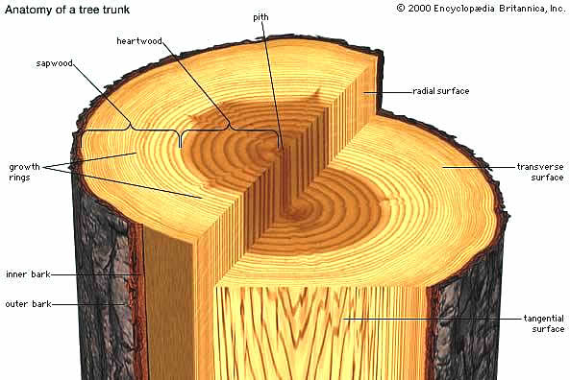
Growth characteristics
The cross-section of a tree trunk or branch reveals a number of concentric rings, with the innermost ring being the oldest. The trunk thickness increases by the addition of new rings, usually one ring each year, but because of the exceptions to this rule, they are called growth rings (instead of annual rings).
The rings comprise minute tubular or fibrous cells which transport moisture and nutrients to all parts of the tree. The early wood (springwood) formed during the growth period has large cells, while in the dry season the late wood (summerwood) grows more slowly, has thicker cell walls and smaller apertures, forming a narrower, denser and darker ring, which gives the tree structural strength.

Slide 6
As each new ring forms a new band of "active" sapwood, starch is extracted from an inner sapwood ring (sometimes substituted by natural toxins) adding a further ring to the "inactive" heartwood core. Mechanically there is hardly any difference between sapwood and heartwood, but sapwood is usually lighter in color and contains substances (eg starch, sugar, water) which attract fungi and some insects.
The slower the tree grows, the narrower are the growth rings, and the denser and stronger is the timber. Its resistance to biological hazards is also usually greater

Slide 7
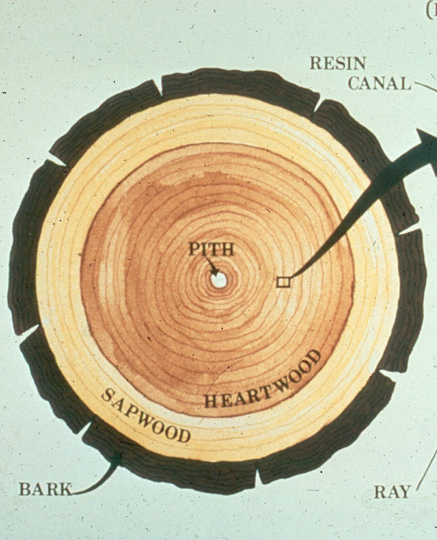
Structure of wood
Pith
The centre of tree growth.
Heartwood
Fully developed mature section in the centre of the tree. Due to the gum or resin contained in the wood cells it is usually darker in colour than sapwood. Its main function is to support the tree as it is inactive in nature.
Sapwood
This is newly formed wood that surrounds the heartwood. It is lighter in colour and softer than the heartwood. The sapwood gradually matures and hardens into heartwood as the tree grows. Sapwood is less resilient to decay and insect attack.
Bark (or Cortex) - Outer Bark
This is the rough layer on the outside of the tree. It acts as a layer of protection against the cold, extreme heat or insect attack.

Slide 8
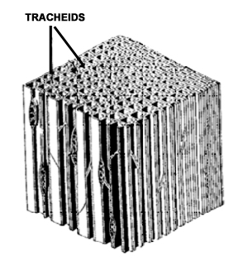
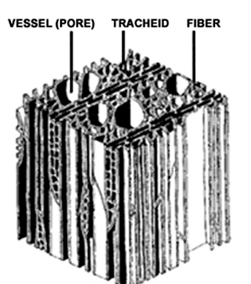
Classification of Timber
Softwoods
These trees are non-porous
Suitable for structural purposes Fairly strong and easily worked
Eg. Pines etc.
Hardwoods
These trees are porous
Mainly used for decorative purposes
Eg. Oak etc.
Schematic diagram of softwood
Schematic diagram of hardwood

Slide 9
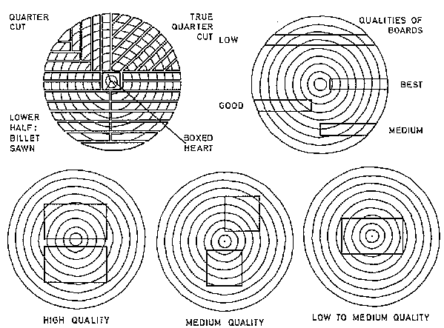
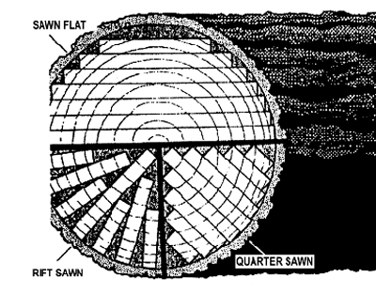
Methods of sawing logs for Timber
Qualities of boards
Notes:
The density of wood is a reliable indicator of many of its structural n mechanical properties

Slide 10
Why seasoning of timber is required…????

Slide 11
SEASONING
After sawing timber has to be seasoned or dried to a moisture content suitable for the purpose for which it is to be used.
Advantages: 1. Durability and strength is increased. 2. Work ability is improved. 3. Fatigue of worker is reduced due to decrease in weight. 4. Distortion is minimized. 5. Surface finish is improved. 6. Resistance to fire is increased. 7. Ability for polishing and painting is improved
Notes:
The density of wood is a reliable indicator of many of its structural n mechanical properties

Slide 12
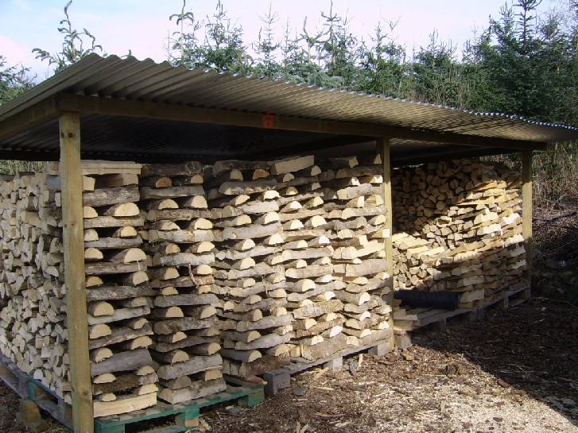
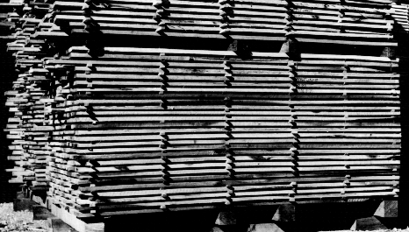
Natural (on air) seasoning
The seasoning of timber is carried out by natural air. Sawed timber is stacked in layers on a platform of brick or concrete pillars. Each layer is separated by spacers. The stack is covered by a roof of a suitable material to protect it from, fast blowing wind, rain and heat.
The moisture content that can be achieved by this method is about 18-22%. This is a simpler and more economical but slower method of seasoning timber but produces stronger timber than that obtained by artificial seasoning.
Notes:
The density of wood is a reliable indicator of many of its structural n mechanical properties

Slide 13
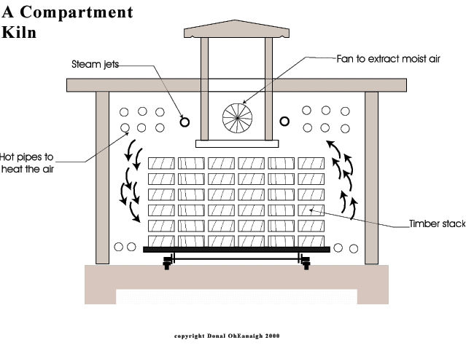
Artificial seasoning
With artificial seasoning, the moisture content of the wood can be reduced to any desired level and the timber produced is less liable to insect and fungi attacks. The various methods of artificial seasoning are:
Boiling: The timber is soak up in water and water is then boiled for about 3 – 4 hours. It is then dried very slowly under a shed. The periods of seasoning and shrinkage are reduced by this method.
Kiln seasoning: Quick method of drying timber to the required moisture content. Air is blown through the kiln, the temperature and humidity of the air being regulated to effect seasoning more rapidly than with natural seasoning and in a controlled manner to avoid damage to the timber.
Notes:
The density of wood is a reliable indicator of many of its structural n mechanical properties

Slide 14
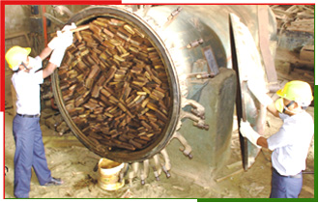
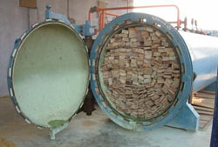
Chemical seasoning
Also known as salt seasoning. The timber is immersed in a solution of a suitable salt. It is then taken out and seasoned by air seasoning.
Water seasoning:
The timber is cut into pieces of suitable sizes and immersed wholly in water, preferably in the running water of a stream. The timber is taken out after a period of 2 – 4 weeks. During this period, the sap contained in the timber is washed away by water. The timber is then allowed to dry under a shed. This is done to dry out the water that has replaced the sap in the timber and season it completely.
Notes:
The density of wood is a reliable indicator of many of its structural n mechanical properties

Slide 15
Types and properties of timbers
• Timber for building construction is divided into two categories:
primary and
secondary timber species.
• Primary timbers are generally slow-grown, aesthetically appealing hardwoods which have considerable natural resistance to biological attack, moisture movement and distortion. As a result, they are expensive and in short supply.
• Secondary timbers are mainly fast-grown species with low natural durability, however, with appropriate seasoning and preservative treatment, their physical properties and durability can be greatly improved. With the rising costs and diminishing supplies of primary timbers, the importance of using secondary species is rapidly increasing.

Slide 16
DENSITY
Density of wood is defined as the mass or weight per unit volume.
Moisture in wood has a very large effect on the specific gravity as well as the density.
Timbers of young tree has a very low density, therefore reduced stresses used for such material.
Weight of timber reduced by drying while most strength properties are increased.
The higher the density, so the higher it’s mechanical properties.
MOISTURE CONTENT
Moisture content in a living tree varies with the species.
Even in the same species, variation in moisture content depends on the age & size of the tree and its location.
Strength of wood increase as the moisture content decreases
Moisture content is determined by oven-dry method or by electric moisture-meter method
Drying of timber from the green condition to cut as constructional usable, 18% moisture content will cause shrinkage.

Slide 17
Advantages of using Timber
Many varieties of timber have surface patterns with infinite variations in grain, texture and colour.
Lightweight material, easy to cut, shape and join with nails, screws, bolts etc. or can be fastened with adhesives
It has favorable weight to strength and weight to modulus of elasticity ratio, which makes it usable as a structural material.
Timber burns only at temperatures of about 350°C . The resistance of timber to damage by fire varies enormously and depends on the size of timber and sort of wood from which it was cut.
Timber is a durable material, in case of possibility of an attack, timber can be made to last by applying fungicides and insecticides.
Timber is a renewable material.

Slide 18
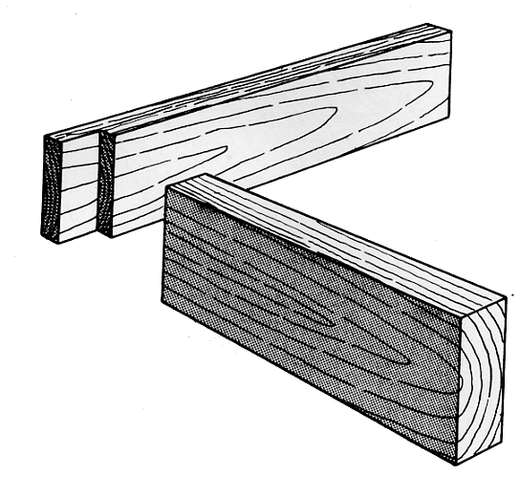
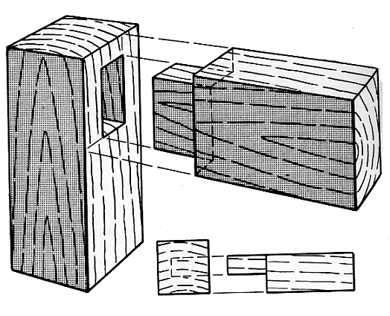
Joinery
The process of connecting or joining two pieces of wood together through the use of various forms of wood joints.
In basic materials processing, common forms of joinery include dovetail joints, mortise-and-tenon joints, biscuit joints, lap joints, and spline joints.

Slide 19
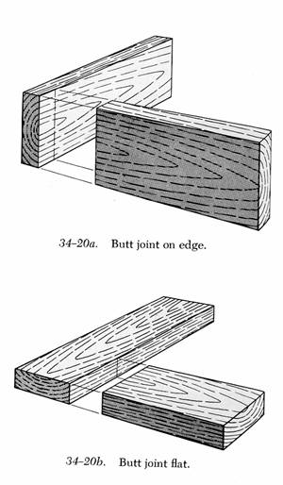
Joinery - Butt Joint
An easy but often weak technique for joining two boards together simply by gluing and pressing two flat surfaces together.
Typically made by gluing an end to an adjoining flat surface.

Slide 20
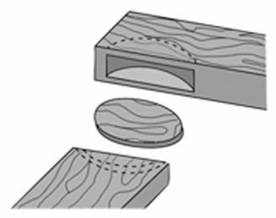
Joinery - Biscuit Joint
A butt joint that is reinforced with football- or ovel-shaped wooden "biscuits."
Biscuits are usually made from compressed wood, frequently birch wood.
When the biscuit comes into contact with glue in the biscuit slot, it swells thus creating a tighter joint.
Sometimes called a plate joint.

Slide 21
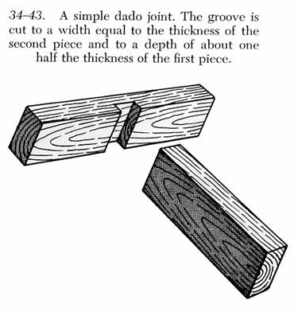
Joinery - Dado Joint
A joint where one piece is grooved to receive the piece which forms the other part of the joint.
Dado (definition)
A groove which is cut across the grain to receive the butt end or edge of a second piece.

Slide 22
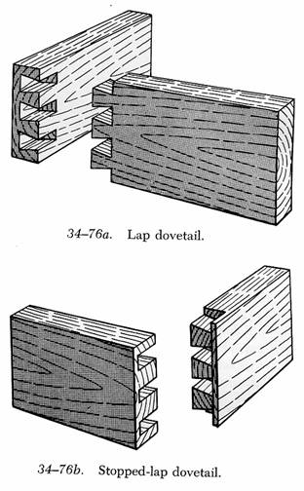
Joinery - Dovetail Joint
Joining two boards in which alternating slots (or tails) and protrusions (or pins), each resembling in shape the v-shaped outline of a bird's tail, are snugly fitted together, thus increasing the gluing area.
Produces a joint that, even without glue, can be difficult to pull apart.
Regarded as one of the strongest and most reliable forms of wood joinery.

Slide 23
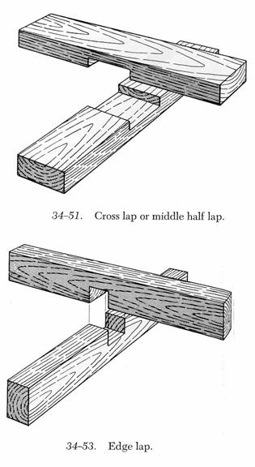
Joinery - Lap Joint
A joint where one piece of wood is crossed over another.

Slide 24
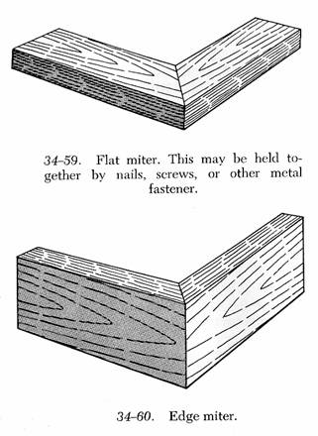
Joinery - Miter Joint
The woodworking joint created when two boards are cut at an angle to one another.
The most common miter joint is the 45-degree miter such as the cuts used to build square or rectangular picture frames.

Slide 25
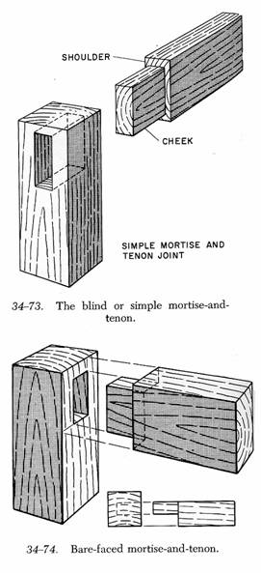
Joinery - Mortise-and-Tenon Joint
A joinery technique where the cut end (tenon) from one board fits into the matching opening (mortise) of another.
Mortise (definition)
An opening chiseled, drilled or routed into a board to receive the end of an intersecting board.
The opening or socket that receives the tenon in the classic woodworker's mortise-and-tenon joint.
Tenon (definition)
The end of a board, cut to a specific size and shape, that is inserted into the mortise, or opening, in a second board.

Slide 26
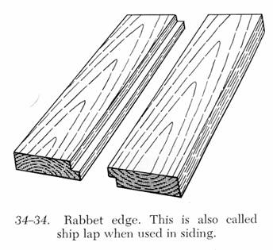
Joinery - Rabbet Joint
A joinery technique where an “L” groove across the end of the edge of one piece of wood fits into a edge or end of another board with an “L” groove.
Rabbet (definition)
A rectangular, stepped recess cut along the edge of a section of wood. (May be used as a verb or noun.)

Slide 27
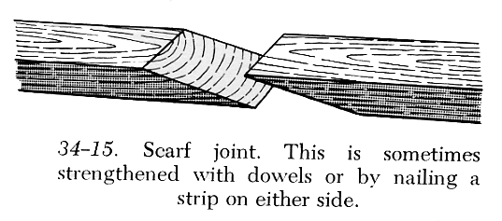
Joinery - Scarf Joint
A joinery technique where two wedge-shaped pieces have been cut to correspond to one another.

Slide 28
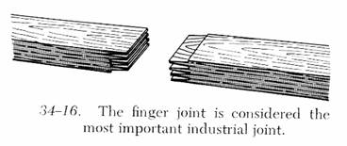
Joinery - Finger Joint
A joinery technique used mostly in industry where small “fingers” are cut into corresponding pieces that will be joined together.
Finger joints are used to making wide boards, in extending the length of dimensional lumber, and in laminated construction.

Slide 29
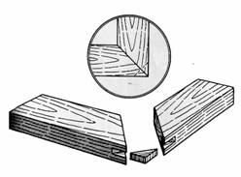
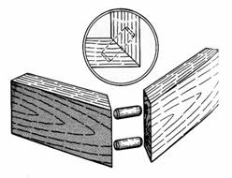
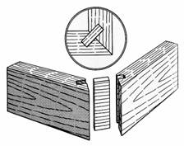
Joinery - Joinery Reinforcements
Key (or Biscuit)
A small, flat lozenge-shaped dowel for edge or corner-jointing. Wood biscuits are fitted into slots that are created with a biscuit jointer.
Dowel pin
Pegs of wood that fit into two matching holes to strengthen a joint.
Spline
A thin piece of wood that fits in the mating grooves cut into two pieces of wood.

